Slide 1
CalcMaster Pro
A Modern Multi-Calculator Desktop Application
NextHikes IT Solution
Developed By
Kiran Jadoun
Python | CustomTkinter | NumPy | Matplotlib

Slide 2
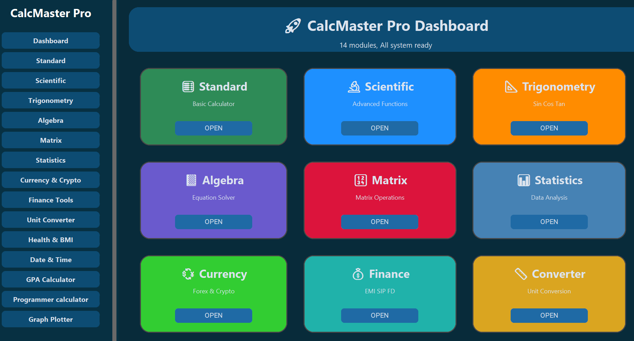
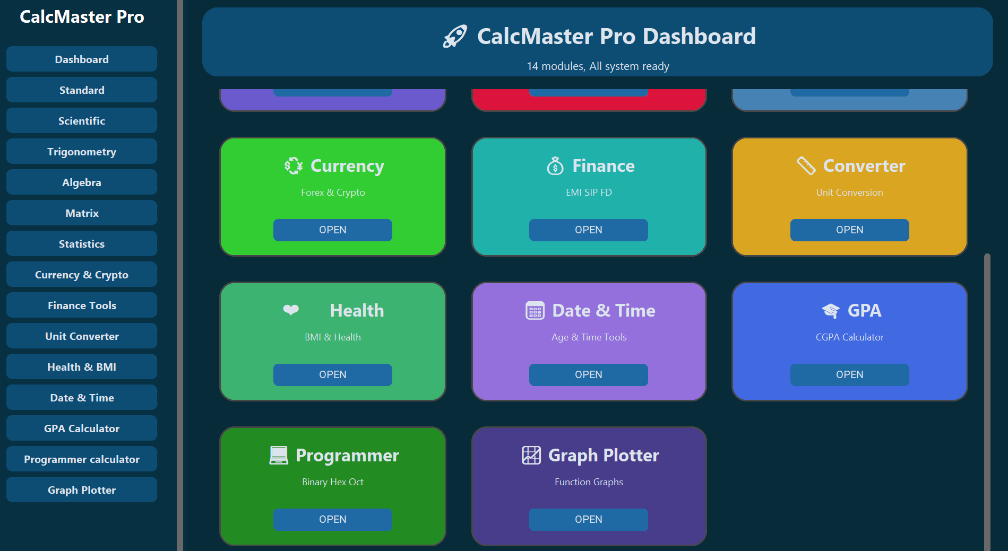
Project Overview & Key Features
Project Overview
All-in-One Desktop Calculator Suite
14 Integrated Calculator Modules
Modern GUI with Sidebar Navigation
Supports Mathematical, academic & Financial Calculations
Key Features
Modern & user-friendly interface
Graph plotting & matrix operations
GPA , Finance & Programmer tools
Fast & accurate calculations

Slide 3
Development Tools & Libraries
Development Tools
VS code for coding and project development
Programming language
Python for application logic and calculations
Libraries Used
CustomTkinter – Modern GUI and dashboard interface
Numpy – Matrix operations and numerical calculations
Matplotlib – Graph plotting and visualization
Math – Scientific and trignomatric calculations
Datetime – Date & time related calculations
Tkinter – Base GUI support and window management

Slide 4
Challenges Faced & References Used
GUI Layout Management
Managed widget alignment and responsive layouts.
Matrix Calculator Integration
Handled dynamic matrix inputs and NumPy operations.
Graph Plotter Development
Implemented graph rendering and navigation features.
Dashboard Navigation
Managed module switching and dashboard navigation.
Solutions implemented
Used frame-based navigation structure.
Applied NumPy for matrix calculations.
Integrated Matplotlib for graph plotting.
Improved UI layout through testing and debugging.
Optimized navigation for smooth module switching.
References Used
Python Documentation
CustomTkinter Documentation
NumPy Documentation
Matplotlib Documentation

Slide 5
Thank You

